Slide 1
Tour and Travelling Management System
Aditi Rajbongshi
ID : CSE 063 07 385
Nazmus Sakib
ID : CSE 057 06 986
Farzana Akhter
ID : CSE 063 07 425

Slide 2

Topic
Data Flow Diagram(DFD)

Slide 3

Activity List(Package Management)
User can search packages, places, hotels, transports.
User can send booking request and also could find another tourists.
Feedback of the request.
Admin manages all type of package.

Slide 4

Activity List(Administration)
Content modification such as add, delete and modify.
Generating report about tour packages and user who booked the tour packages.

Slide 5
Decomposition of DFD
Context Level | Level-0 | Level-1
Tour and Traveling Management System | 1.0 Package Management | 1.1 Record of Package
 |  | 1.2 Place Management
 |  | 1.3 Hotel Management
 |  | 1.4 Transportation Management
 |  | 1.5 Booking Management
 |  | 1.6 Find Tourist
 | 2.0 Administration | 2.1 Content Process
 |  | 2.2 Work Process

Slide 6
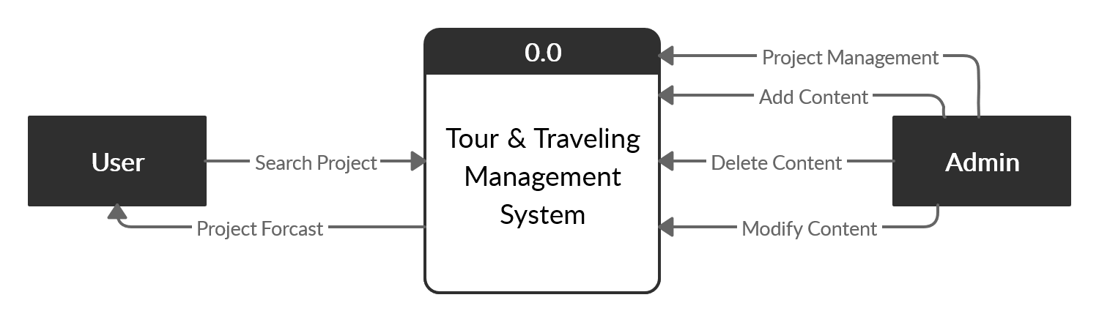
Context Level

Slide 7
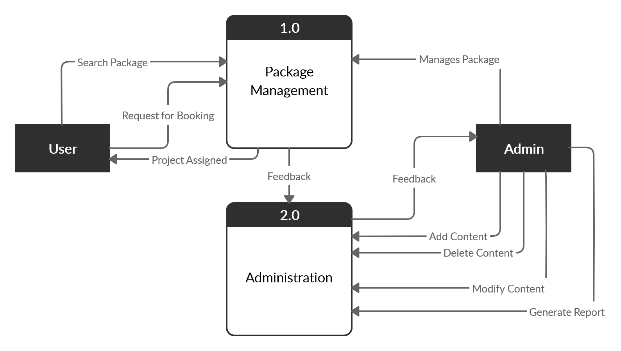
Level-0

Slide 8
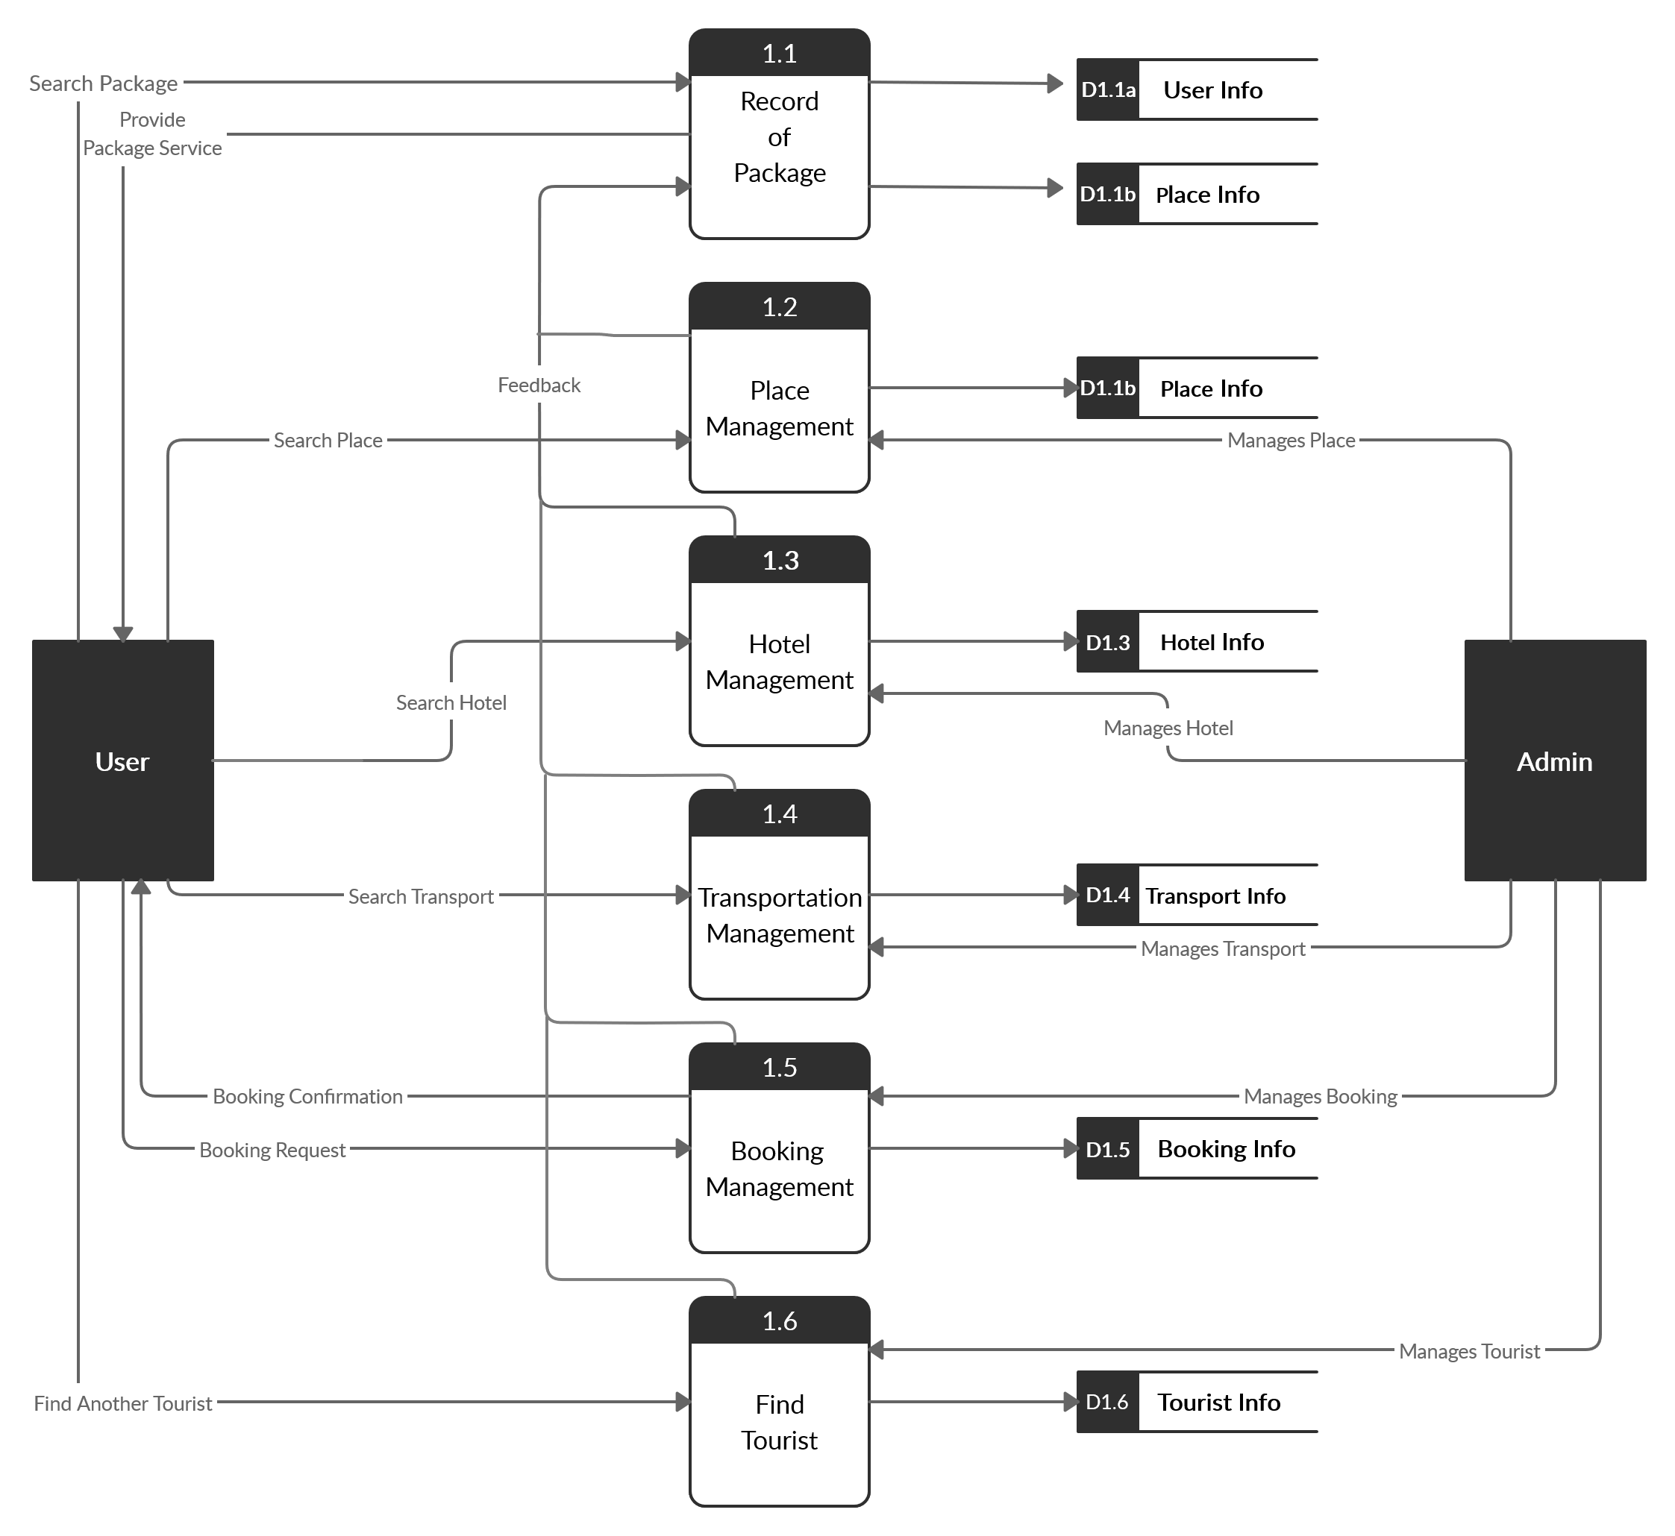
Level-1

Slide 9
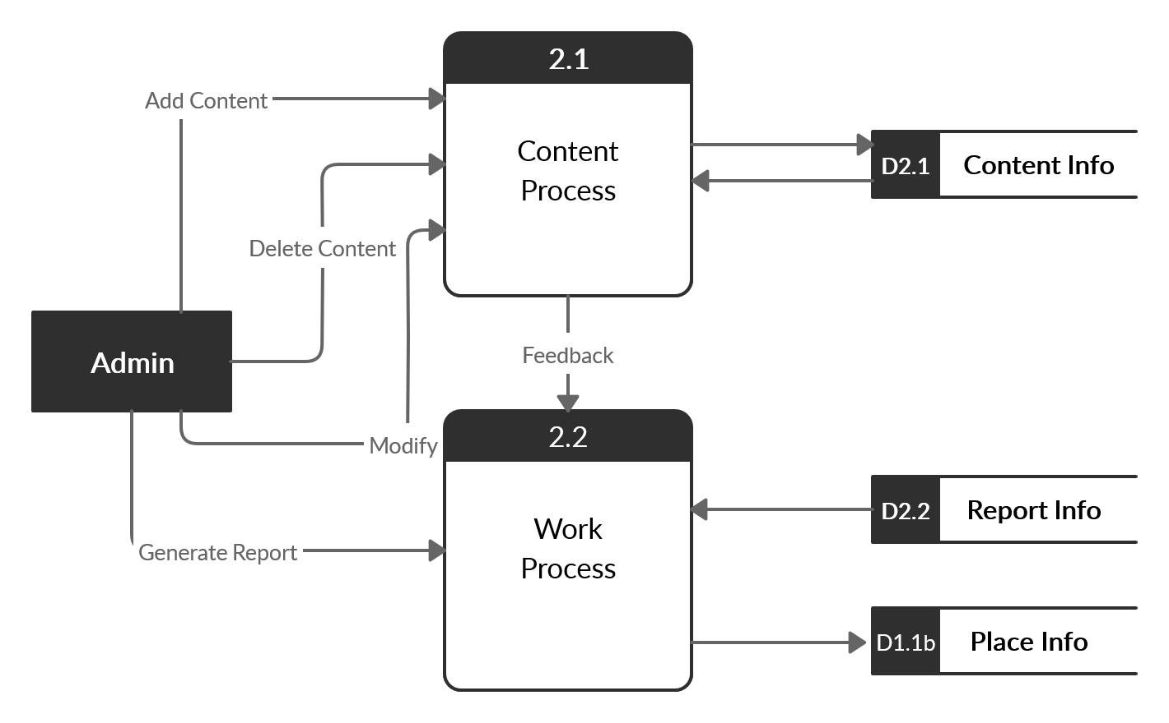
Level-1

